Slide 1
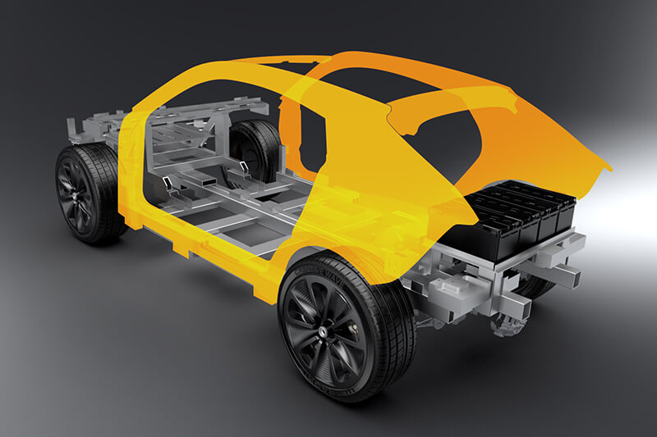
Prototyping and System Engineering

Slide 2
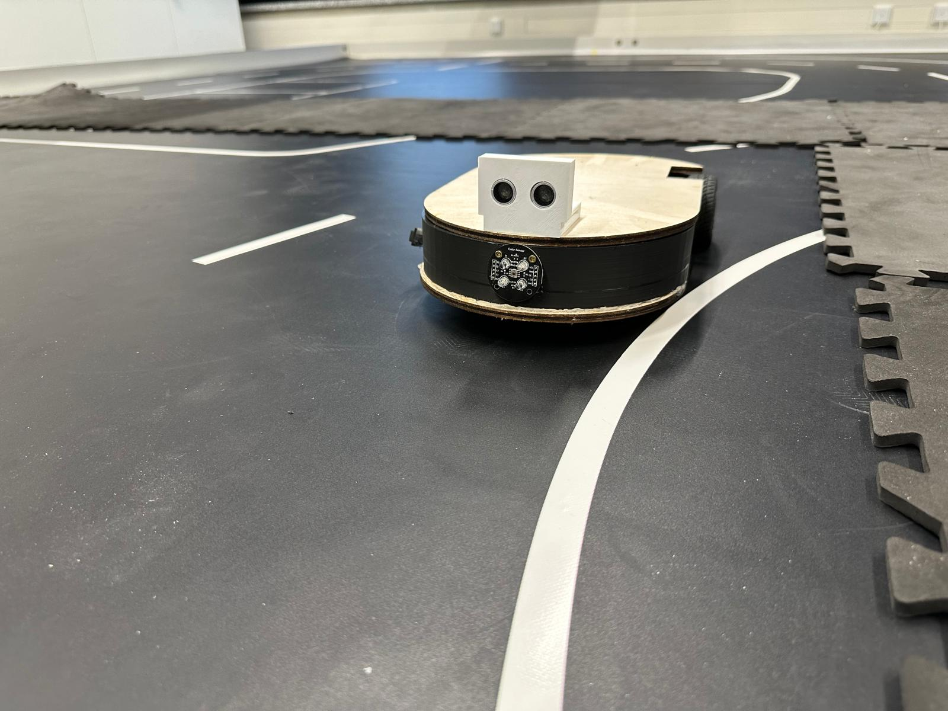
Line Following Robot with Obstacle avoidance based on Color.

Slide 3
Presented By
Moye Nyuysoni Glein Perry
moye-nyuysoni.glein-perry@stud.hshl.de
Md. Tawhidur Rahman Tuhin
md-tawhidur-rahman.tuhin@stud.hshl.de
Raihan Uddin
raihan.uddin@stud.hshl.de
Bodrul Amin Murad
bodrul-amin.murad@stud.hshl.de

Slide 4
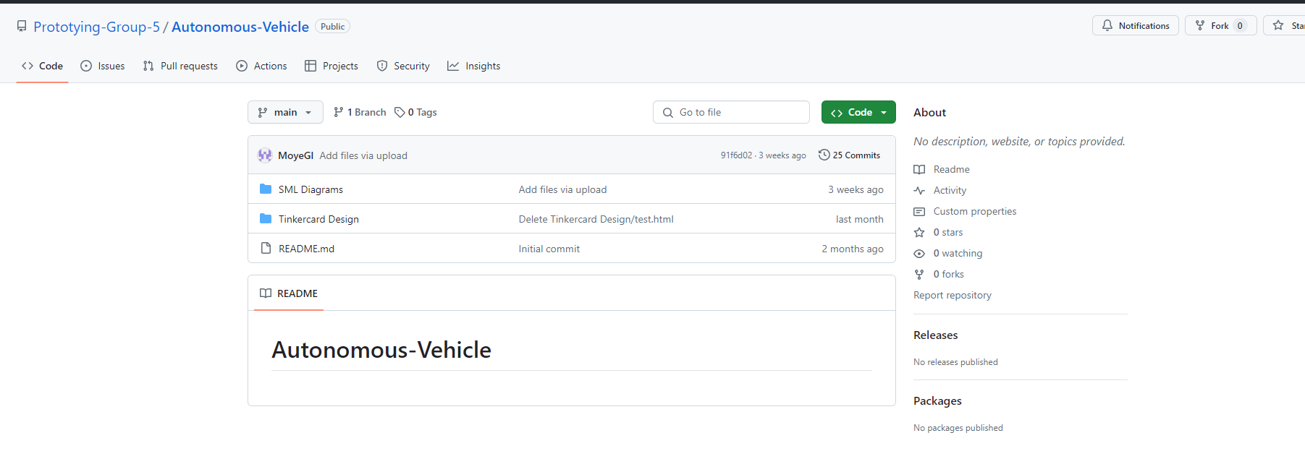
Github

Slide 5
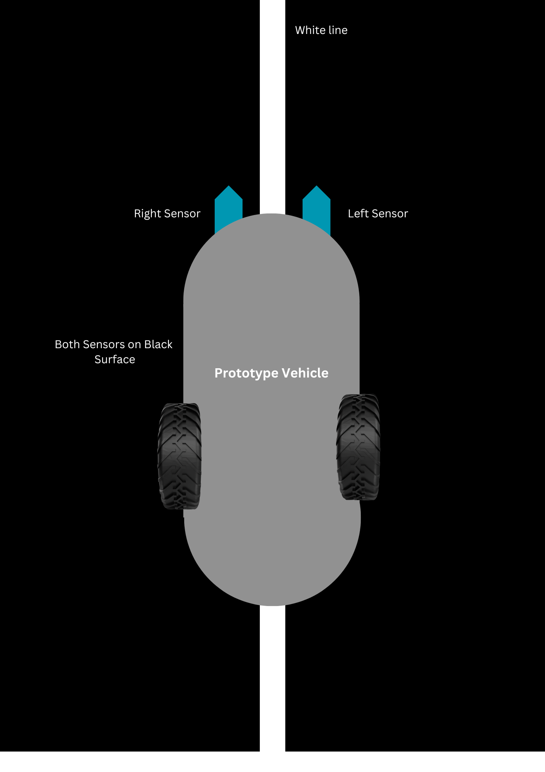
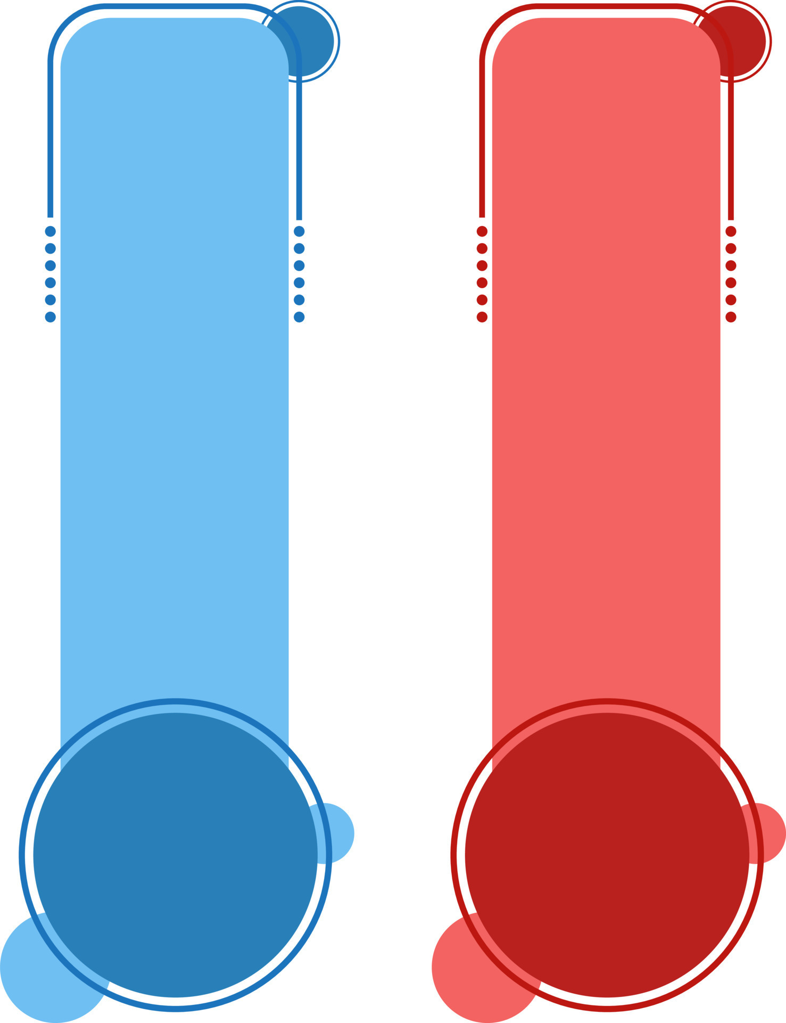
Introduction
Our team has designed and realized a prototype vehicle with three main functions:
Line Following:
The vehicle follows a white line using two IR sensors.
Obstacle Detection:
An ultrasonic sensor is used to detect obstacles in the path of the vehicle.
Action Based on Obstacle Color:
If the obstacle is blue, the vehicle parks.
If the obstacle is red, the vehicle overtakes and returns to the line.

Slide 6
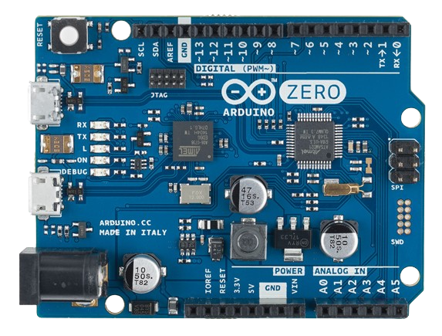
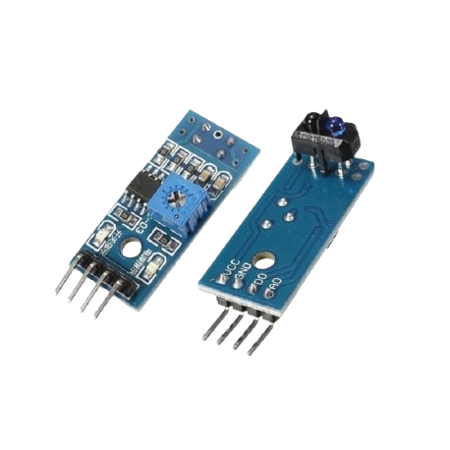
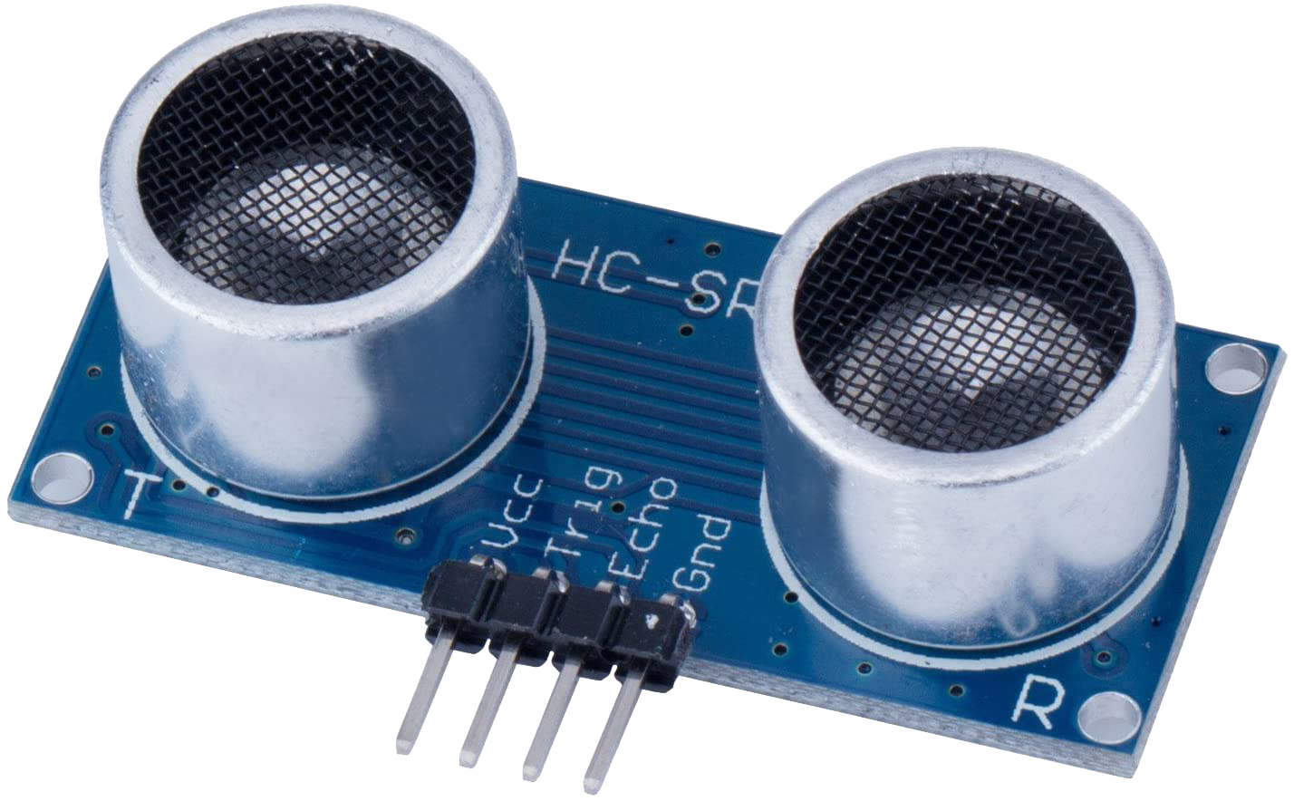
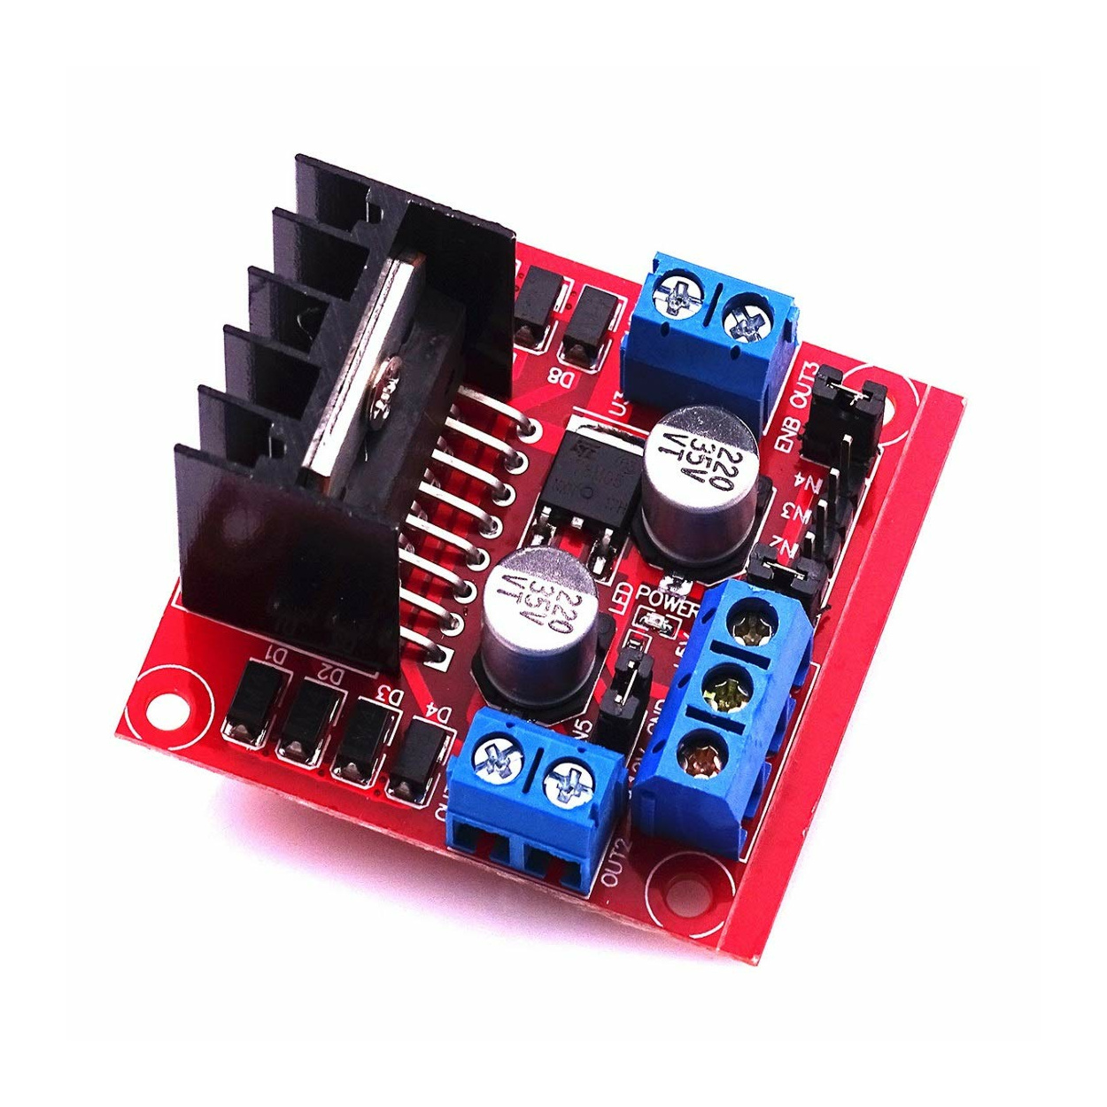
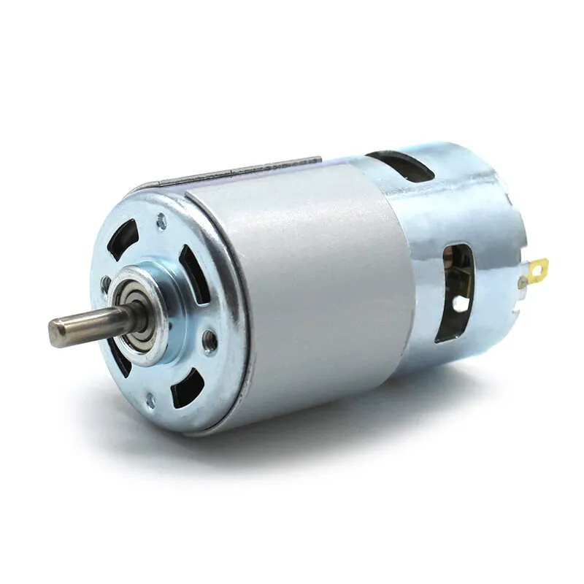
Components Used
Microcontroller (Arduino)
IR Sensors
Ultrasonic Sensor
Motors and Motor Driver

Slide 7
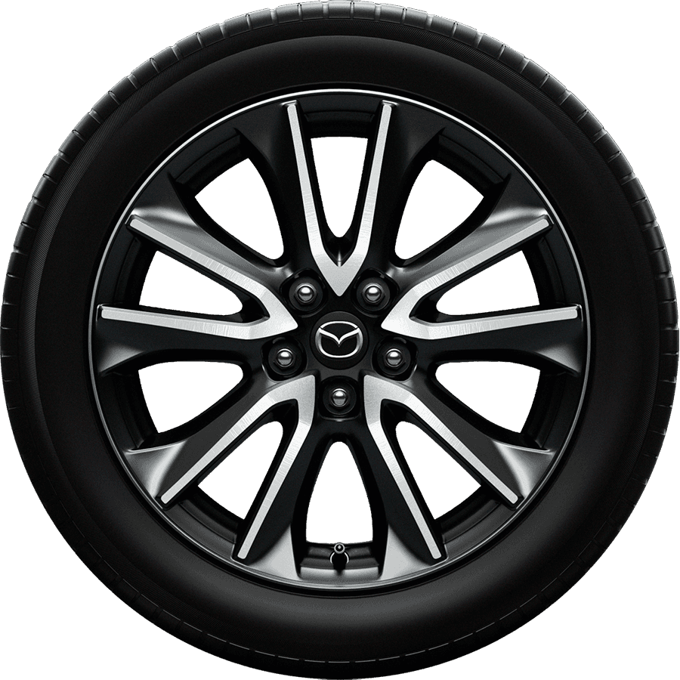
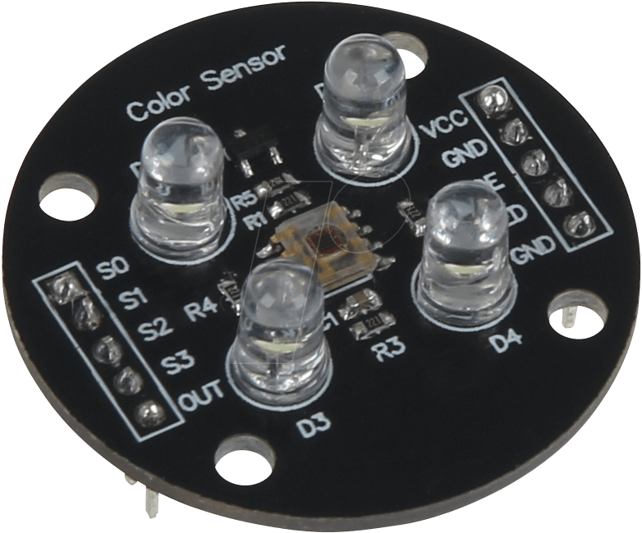
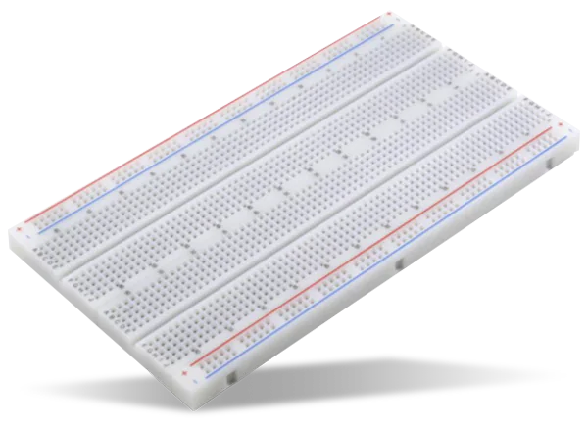
Components Used
Chassis and Wheels
Color Sensor
Power Supply
Breadboard and Connecting Wires

Slide 8
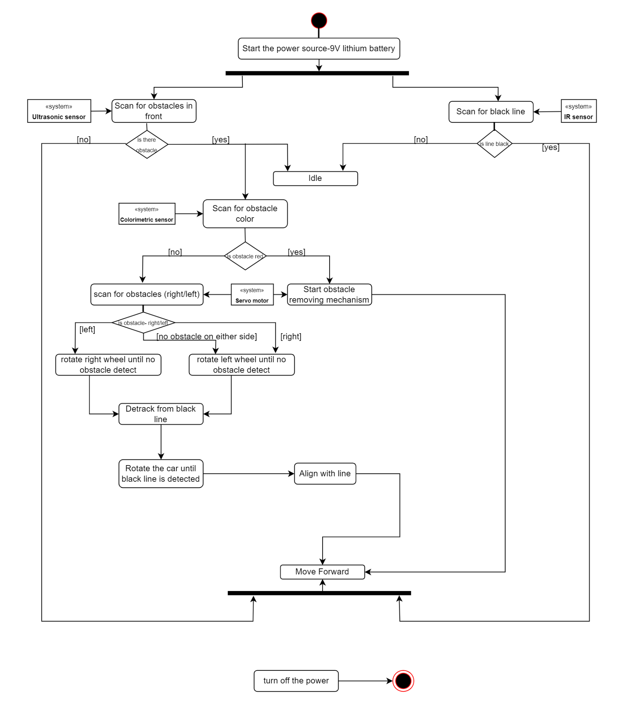
SML Diagrams
Activity Diagram:
Activity Diagram for Robotic System: Black Line Following and Obstacle Handling
1. Start the Power Source
Action: Power on the system using a 9V lithium battery.
2. Initial Actions
Scan for Obstacles in Front: Ultrasonic sensor checks for obstacles.
If Obstacle Detected:
Enter idle mode.
Scan obstacle's color using colorimetric sensor.
If No Obstacle Detected:
Scan for black line using IR sensor.
If Black Line Detected: Go idle.
If No Black Line Detected: Continuously search for it.
3. Obstacle Handling
After Obstacle Detection:
Identify color and scan for side obstacles.
If No Side Obstacle:
Detrack from black line.
Rotate car until black line detected.
Align with line and move forward.
If Side Obstacle Detected:
Determine side with obstacle.
Rotate wheel in opposite direction using servo motor.
Detrack from black line.
Rotate car to find black line.
Align with line and move forward.
4. Idle State
System idles momentarily after detecting black line or handling obstacle.
5. Moving Forward
Action: Move forward along the black line once detected and obstacles are managed.
6. End Process
Action: Turn off the power after task completion.

Slide 9
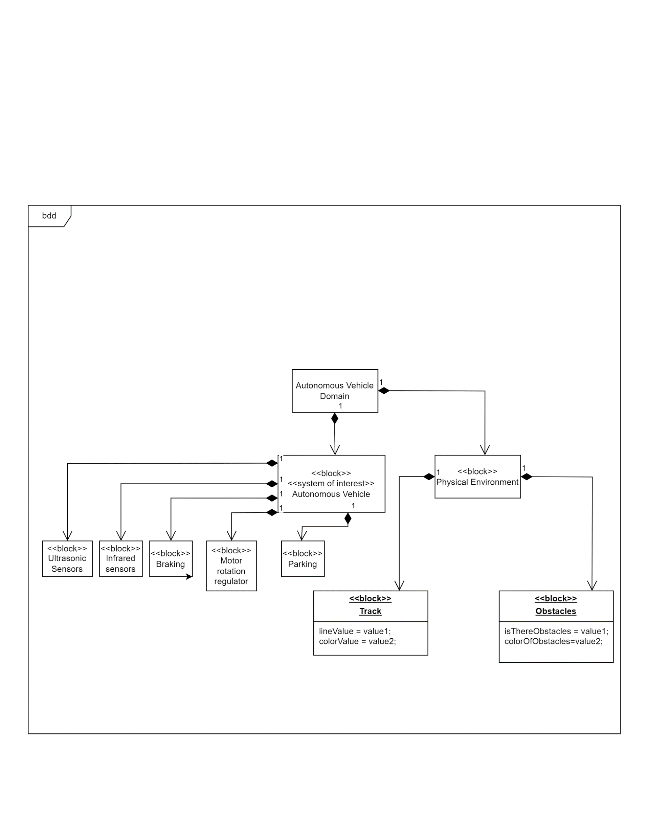
SML Diagrams
Block Diagram:
Block Definition Diagram (BDD) for Autonomous Vehicle System
Main Components
Autonomous Vehicle Domain
Overarching domain encapsulating the autonomous vehicle and its interaction with the physical environment.
System of Interest (Autonomous Vehicle)
Represents the autonomous vehicle itself, containing various subsystems essential for its operation.
Subsystems within the Autonomous Vehicle
Ultrasonic Sensors
Measure distances using ultrasonic waves for obstacle detection.
Infrared Sensors
Detect heat signatures or proximity.
Braking
Handles the vehicle’s braking mechanism.
Motor Rotation Regulator
Controls the rotation of the vehicle’s motors, influencing speed and direction.
Parking
Manages the vehicle's autonomous parking capabilities.

Slide 10
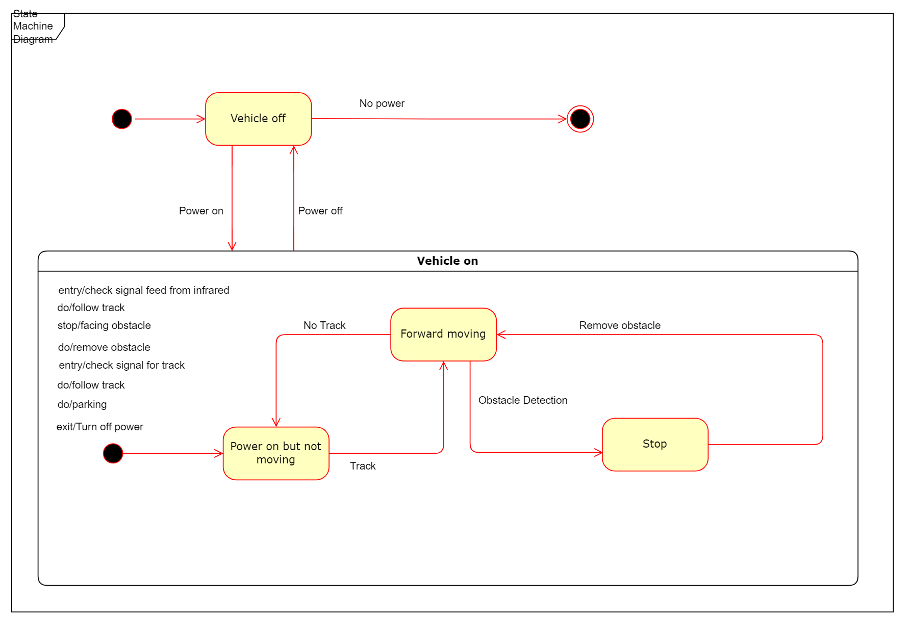
SML Diagrams
State Machine Diagram:

Slide 11
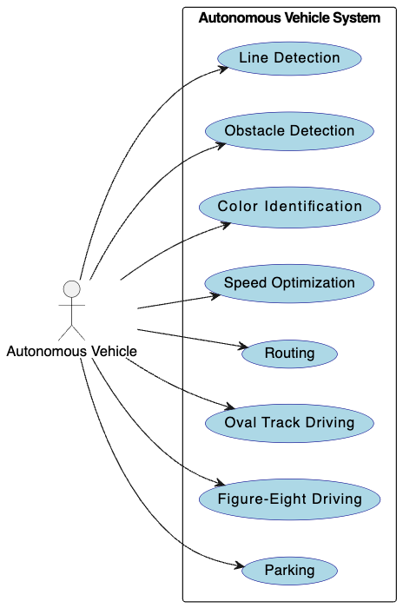
SML Diagrams
Requirement Diagram:

Slide 12
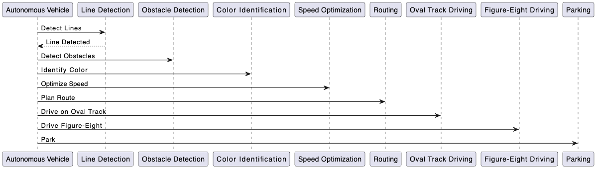
SML Diagrams
Sequence Diagram:

Slide 13
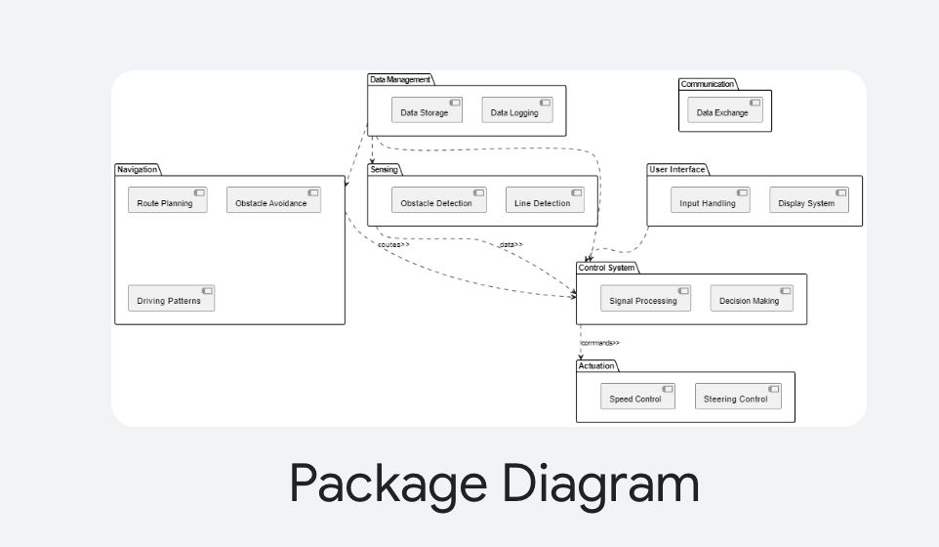
SML Diagrams
Package Diagram:
This picture shows how parts of our Autonomous Driving System are organized."
"There are different parts: Navigation, Data Management, Sensing, Communication, User Interface, Control System, and Actuation."
"Navigation includes 'Route Planning,' 'Obstacle Avoidance,' and 'Driving Patterns.'"
"Data Management stores and logs data."
"Sensing includes 'Obstacle Detection' and 'Line Detection.'"
"Communication handles 'Data Exchange.'"
"User Interface manages inputs and displays."
"Control System includes 'Signal Processing' and 'Decision Making.'"
"Actuation handles 'Speed Control' and 'Steering Control.'"
"All these parts work together to help the car drive by itself."

Slide 14
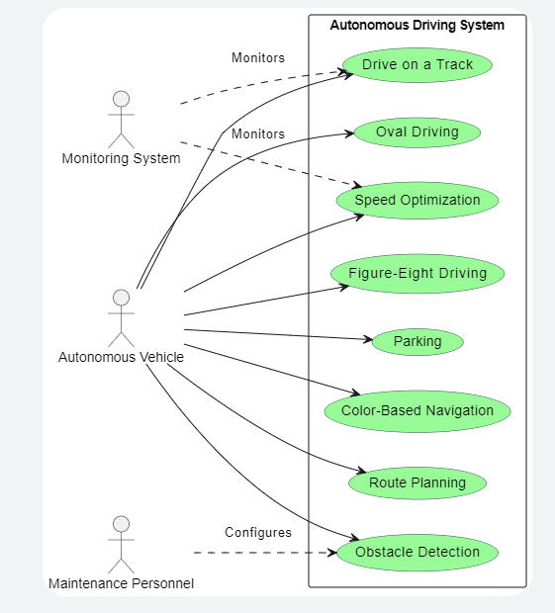
SML Diagrams
"This picture shows what our Autonomous Driving System can do."
"There are three main users: Monitoring System, Autonomous Vehicle, and Maintenance Personnel."
"The Monitoring System watches tasks like 'Drive on a Track,' 'Oval Driving,' and 'Speed Optimization.'"
"The Autonomous Vehicle does 'Figure-Eight Driving,' 'Parking,' 'Color-Based Navigation,' and 'Route Planning.'"
"Maintenance Personnel sets up the system for 'Obstacle Detection.

Slide 15
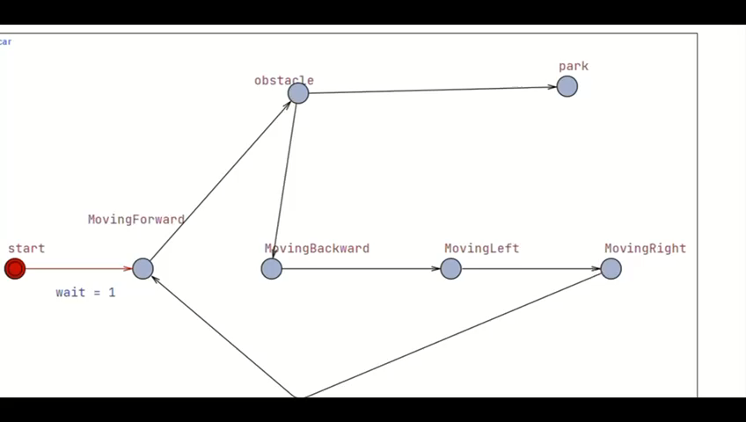
UPPAAL MODEL

Slide 16
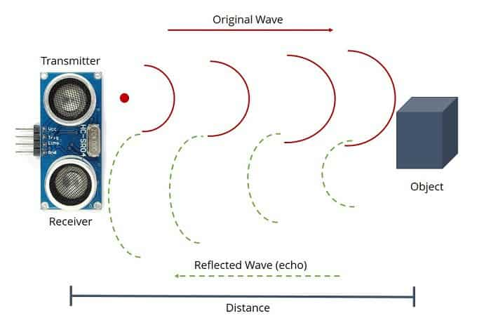
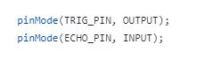
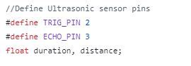
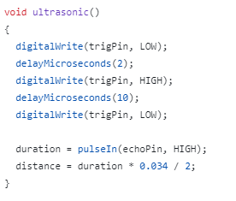
https://nerdyelectronics.com/working-of-an-ultrasonic-sensor/
Ultrasonic sensor implementation
Distance = Speed * duration
Speed of sound in air and it is in meters/s so we have to convert it to cm/microsecond.

Slide 17
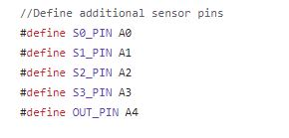
Color Detection implementation
S0 | S1 | Frequency Scaling
L | L | Power down
L | H | 2%
H | L | 20%
H | H | 100%
Color Detected | S2 | S3
Red | LOW | LOW
Green | HIGH | HIGH
Blue | LOW | LOW
Clear (no filter) | HIGH | LOW

Slide 18
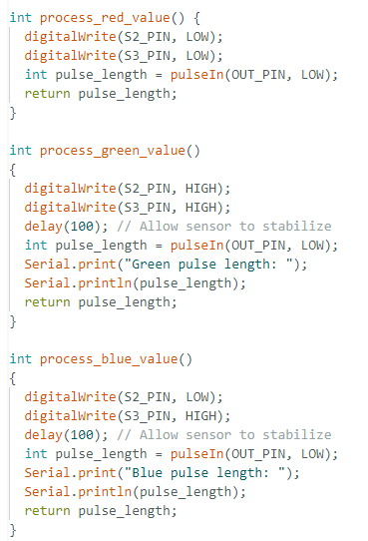
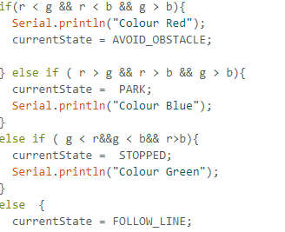
Color Detection implementation
Red
R=28 b=88 G=100
Blue
R=103 b=35 G=60
Green
R=105 b=98 G=84

Slide 19
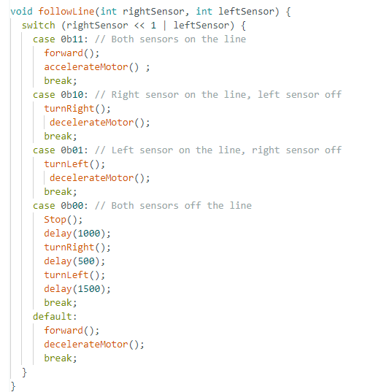
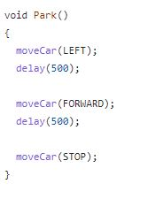
LINE FOLLOWING CODE IMPLEMENTATION
When color blue is detected, call funtion Park()
When color is red detected, call function avoidObstacle()

Slide 20
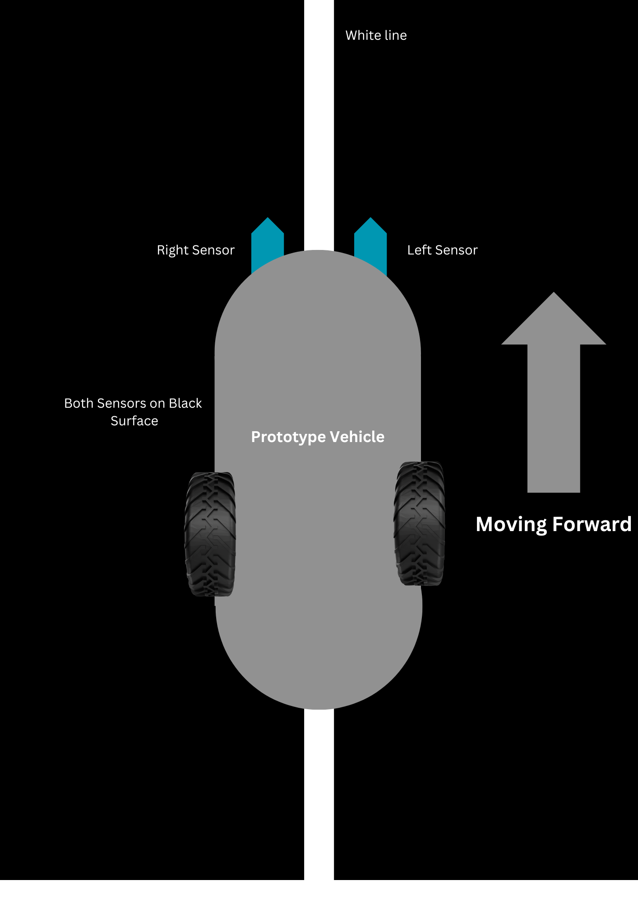

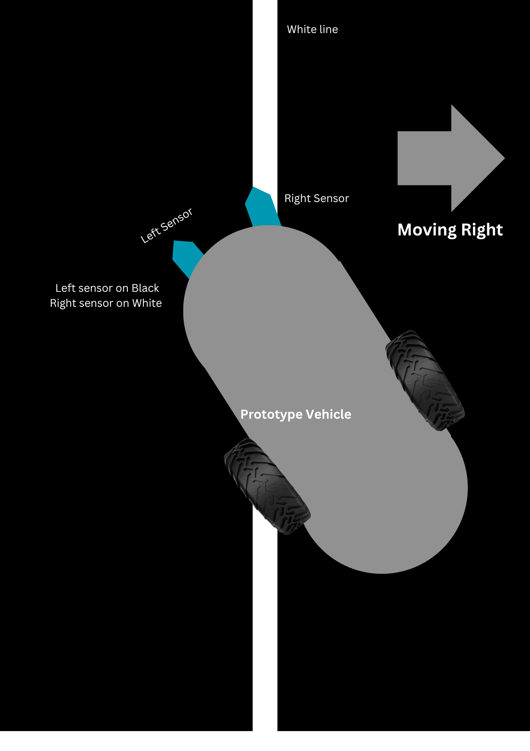
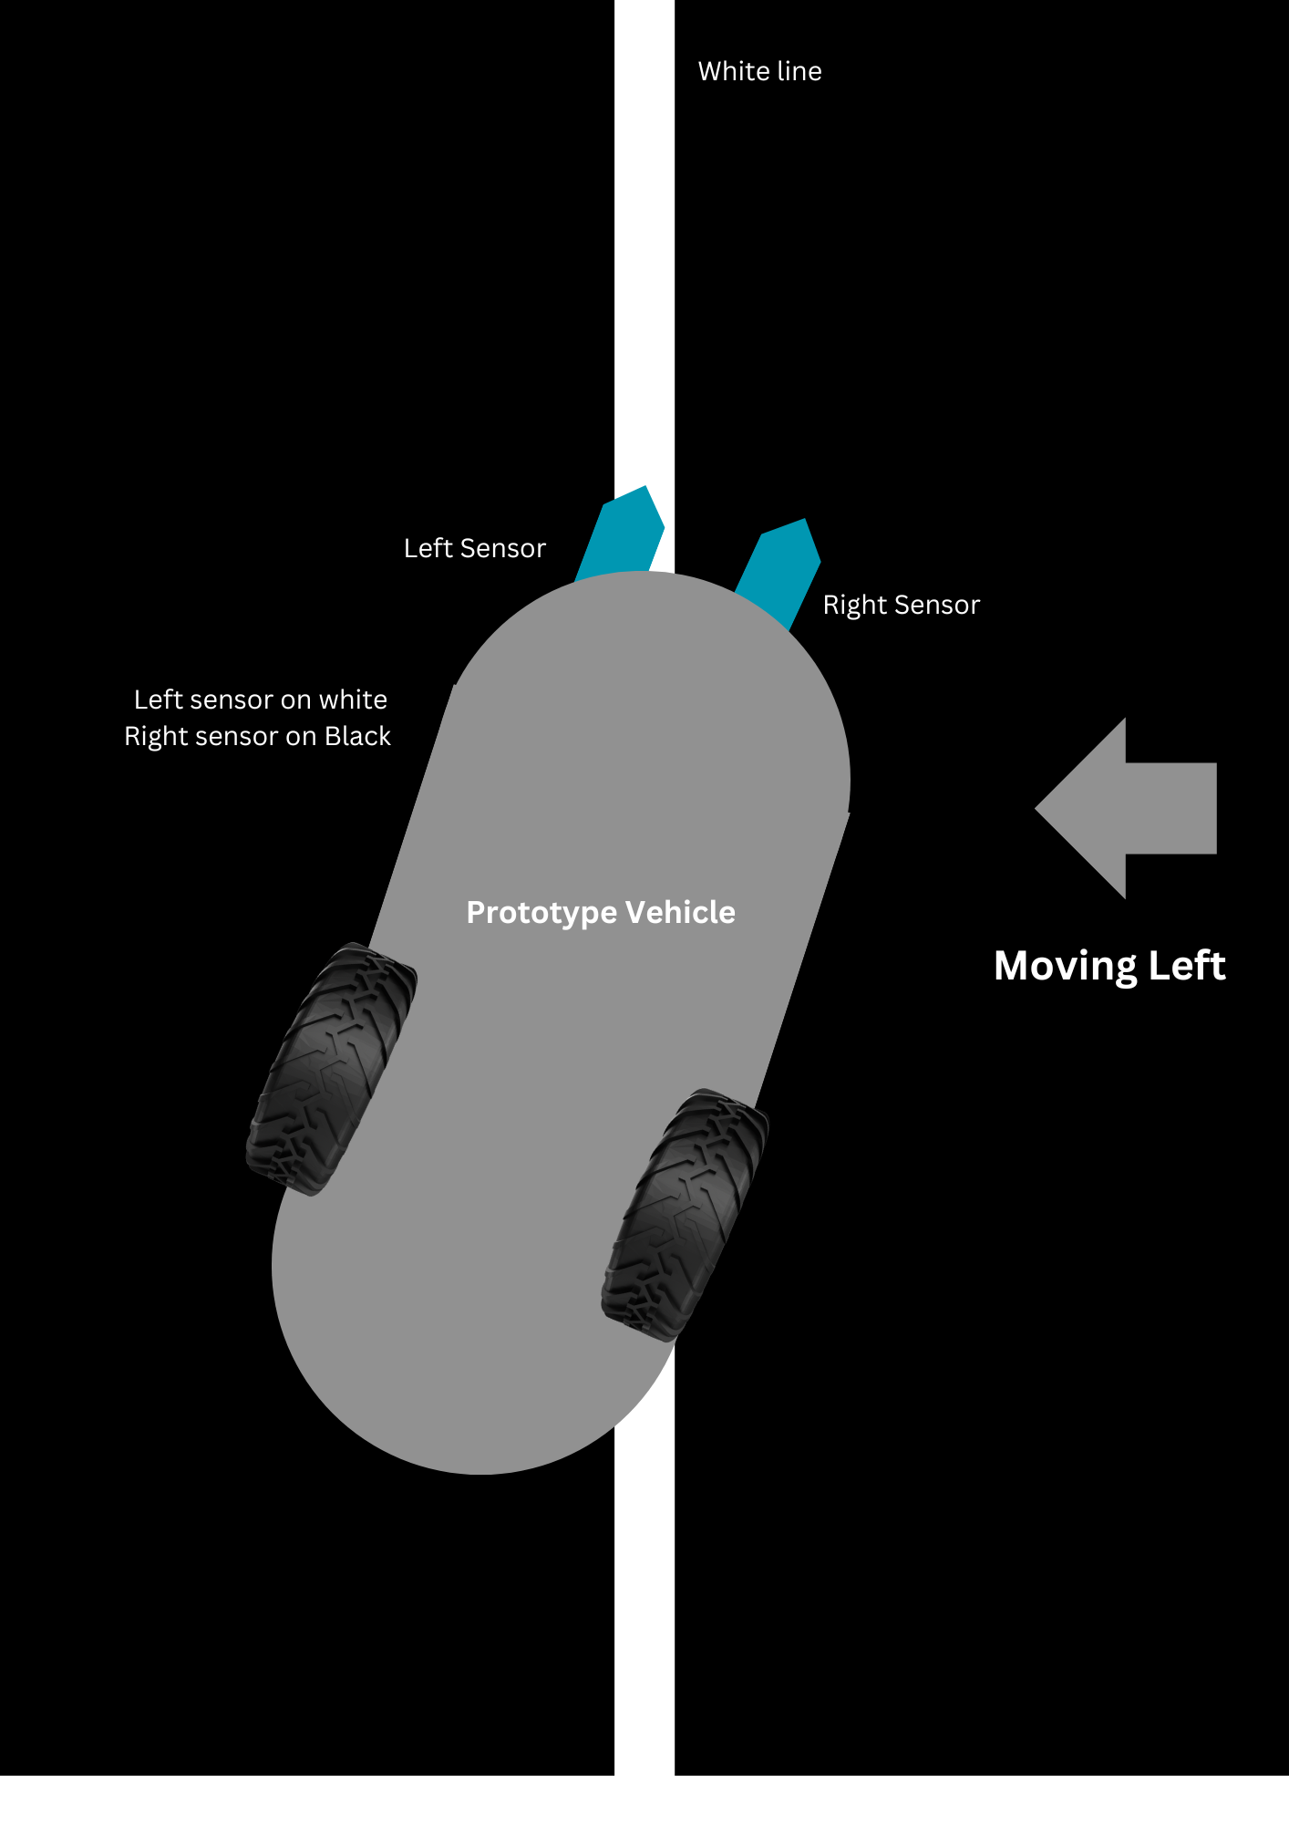
LINE DETECTION IMPLEMENTATION

Slide 21
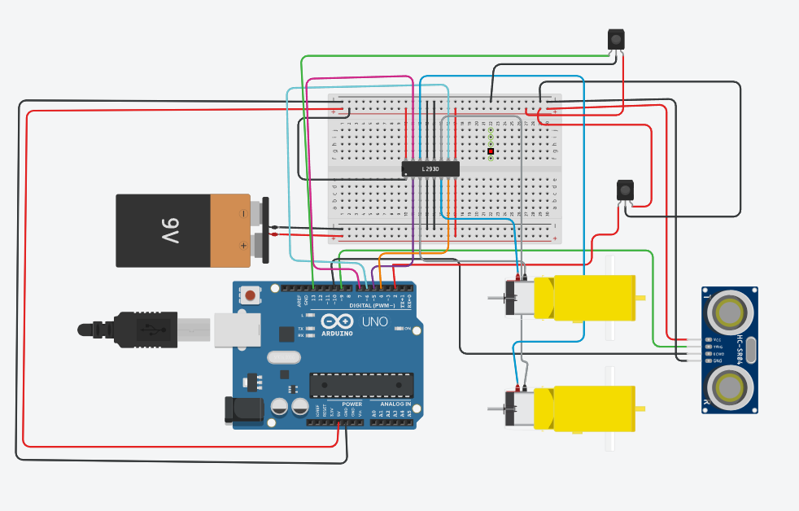
Hardware Implemetation
Circuit :

Slide 22
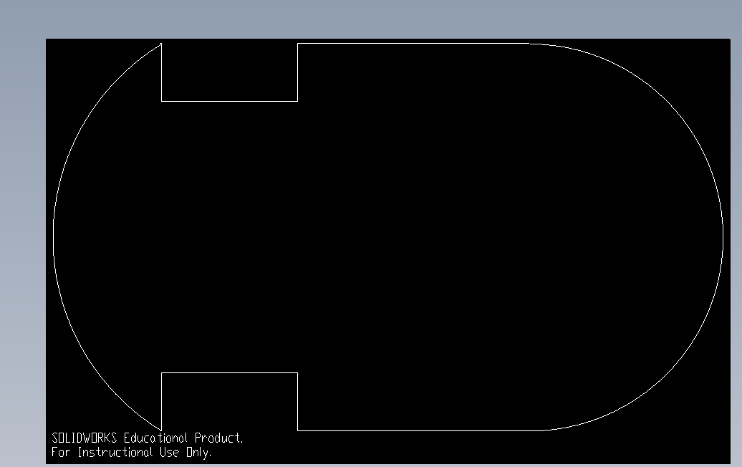
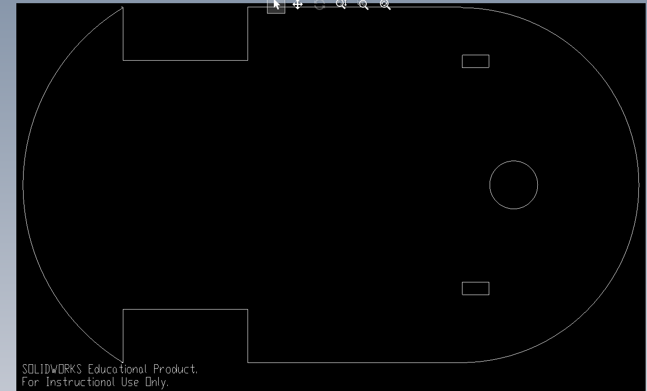
Hardware Implemetation
Laser Cutting:

Slide 23
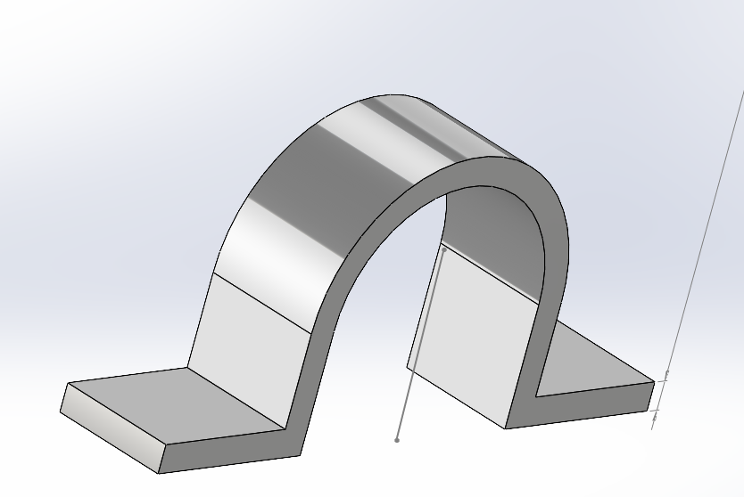
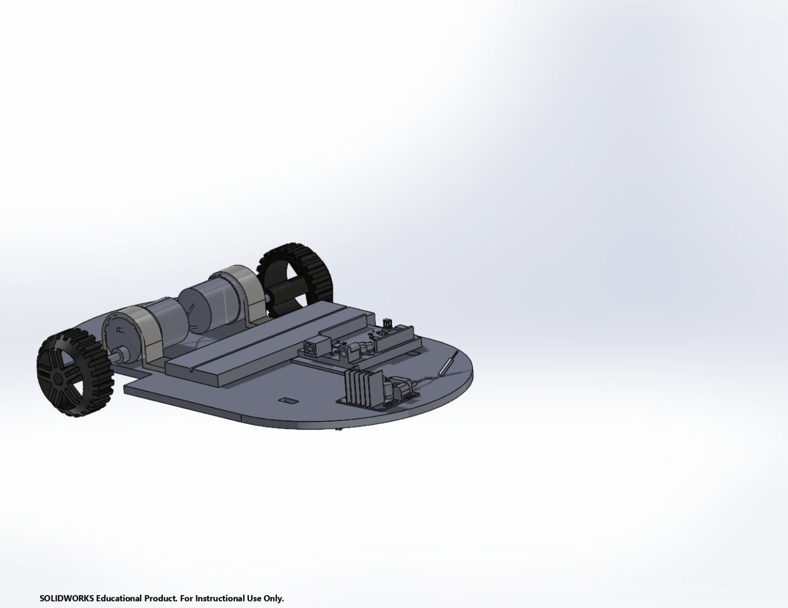
Hardware Implemetation
CAD:

Slide 24
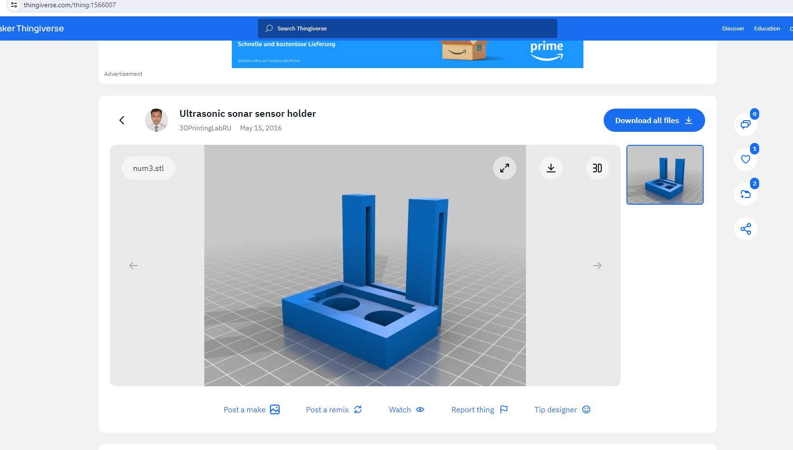
Hardware Implemetation
CAD:
https://www.thingiverse.com/thing:1566007

Slide 25
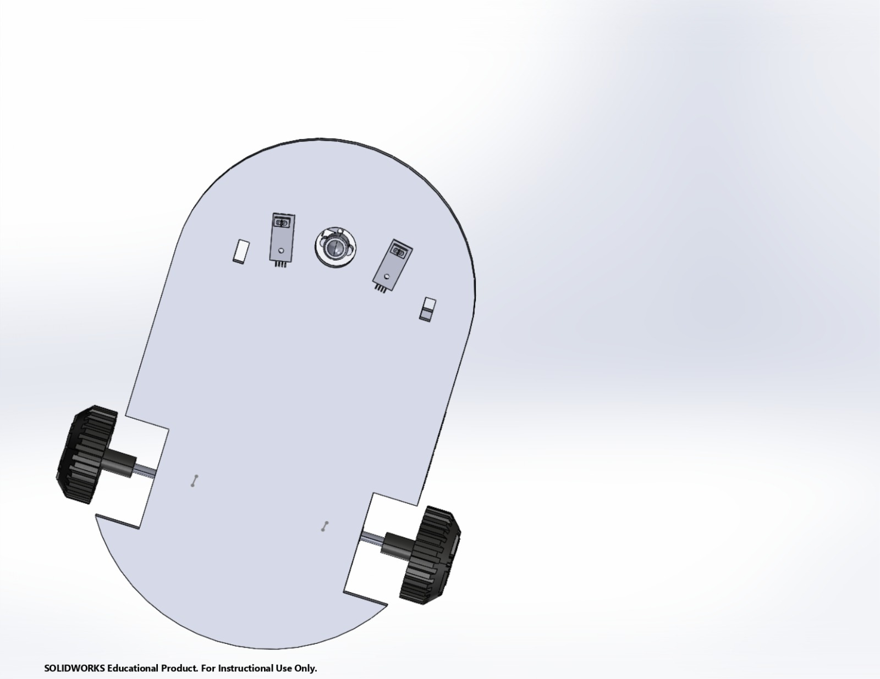
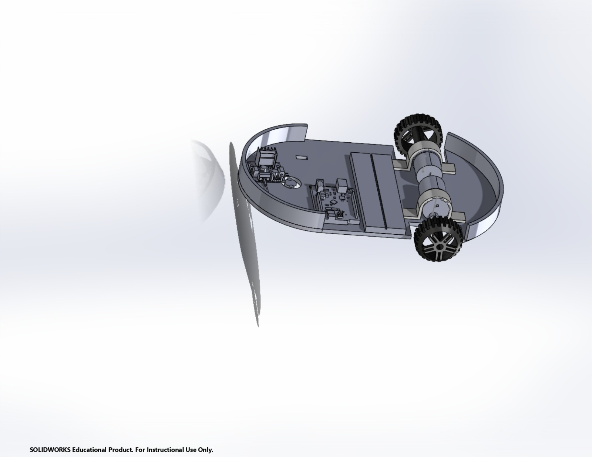
Hardware Implemetation
CAD:

Slide 26
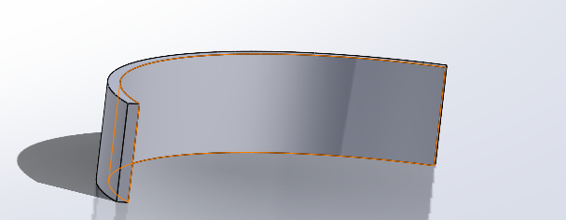
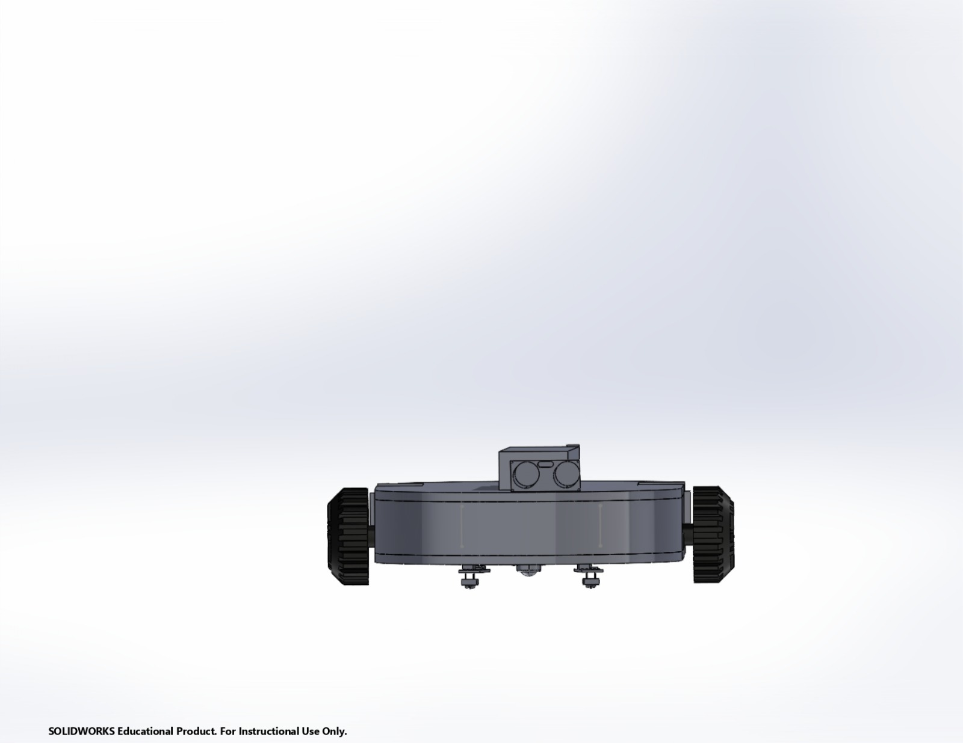
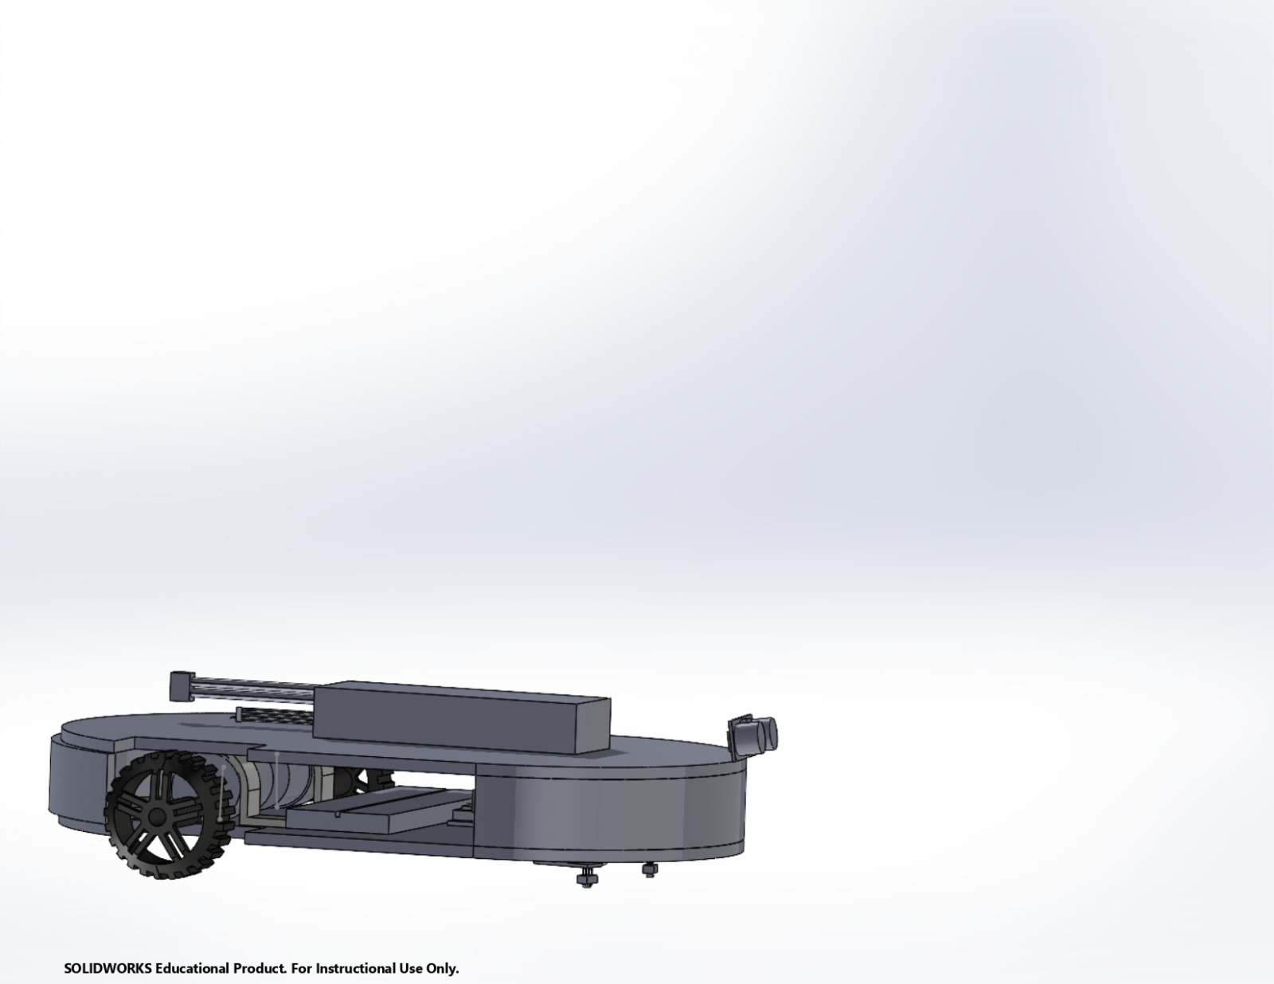
Hardware Implemetation
Final CAD Assembly:

Slide 27
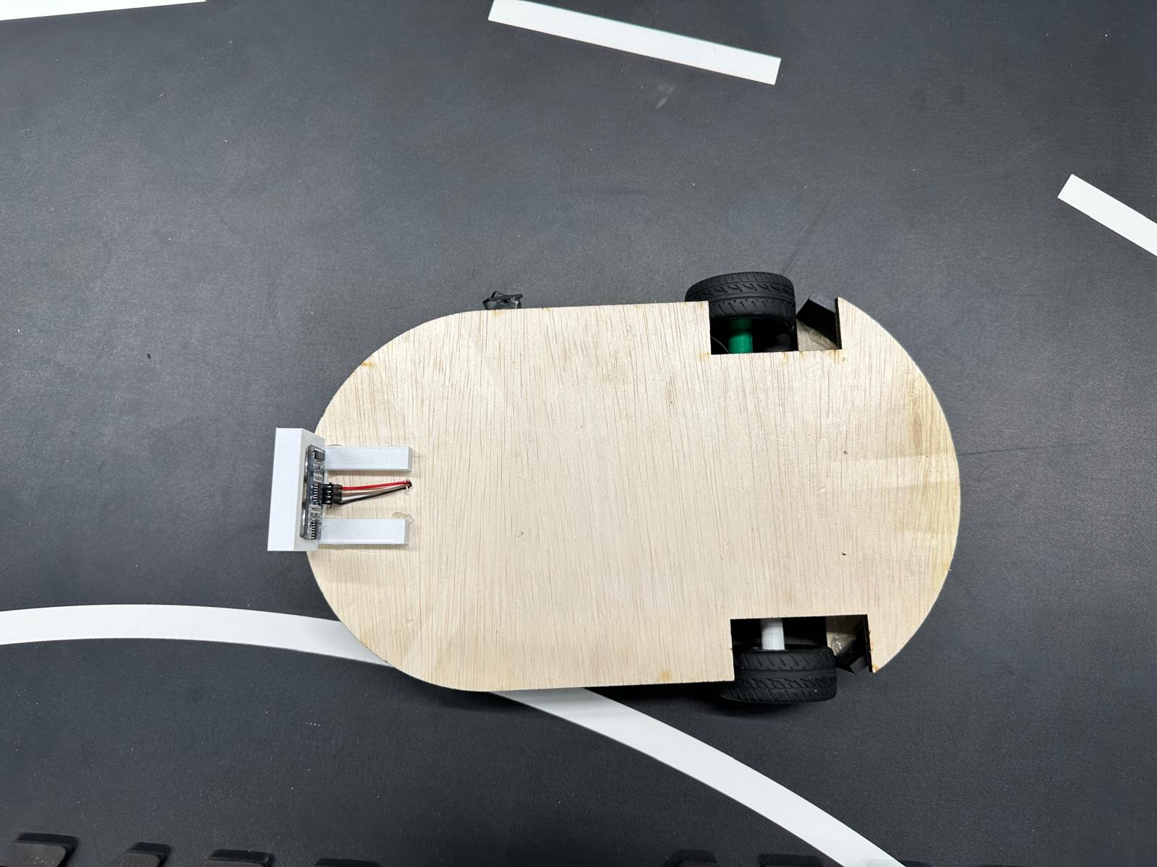
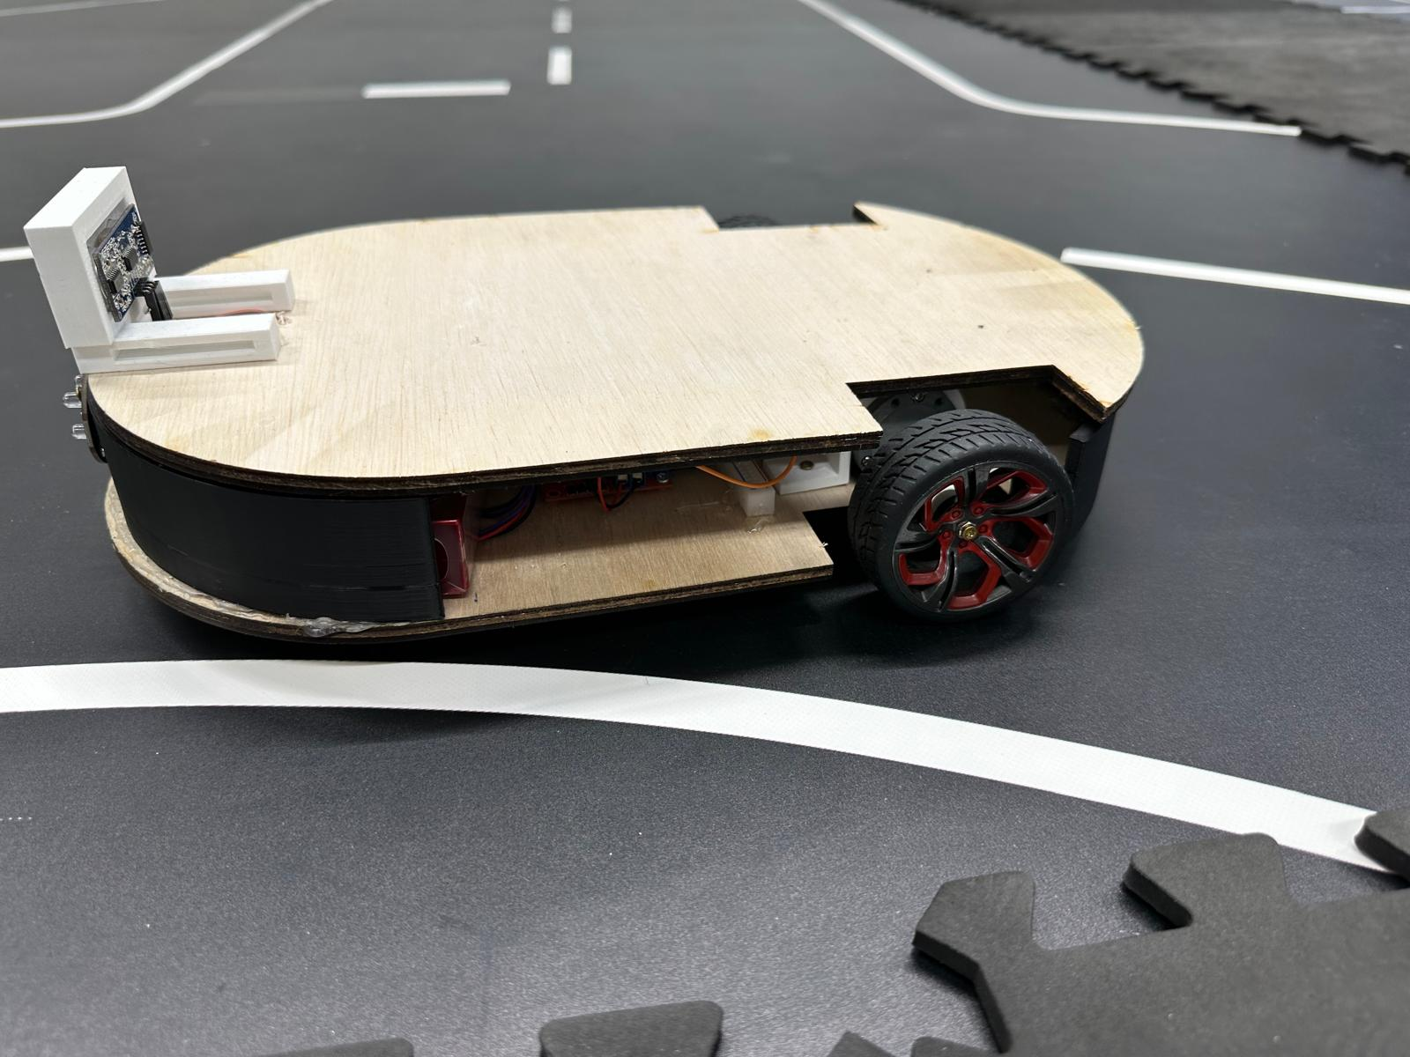
Hardware Implemetation
Final Assembly:

Slide 28
Hardware Implemetation
Final Assembly:

Slide 29
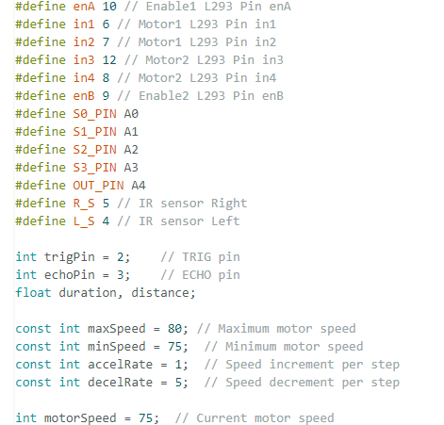
Code Explanation
Step 1: Declare Variables

Slide 30
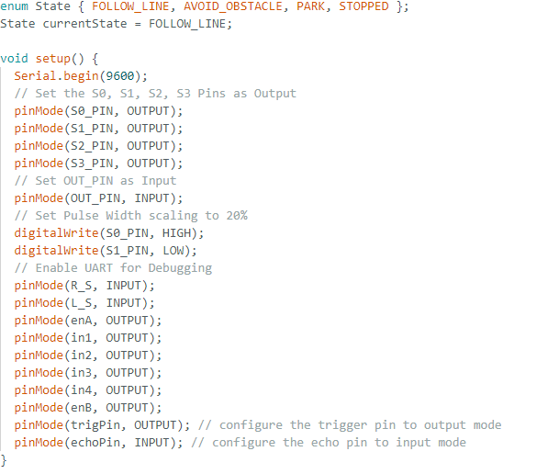
Code Explanation
Step 2: Creation of Enum State, setting current state and pin declarations

Slide 31
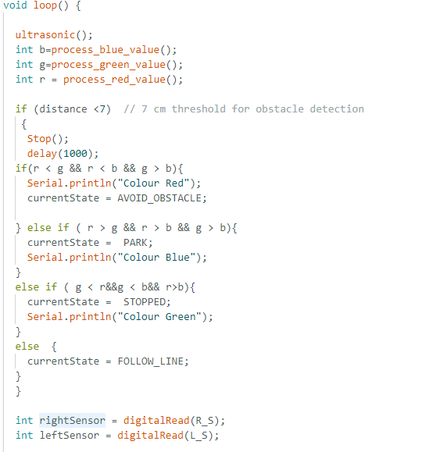
Code Explanation
Step 3: Mian Loop

Slide 32
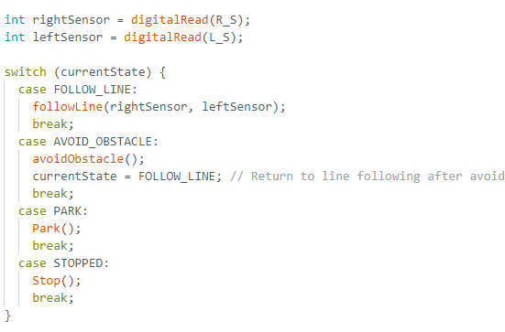
Code Explanation
Step 4: Mian Loop

Slide 33

Code Explanation
Step 4: Important Functions

Slide 34
Assembly Instructions of the vehicle (hardware):
Step 1: Prepare the chassis
Install the Front Wheel:
We have screwed the Front Wheel to the bottom of the chassis. So it can spin effortlessly.
Attach the Tires
Placed the tires along with the motors at the back of the chassis. The tires will touch the ground when they are attached to the chassis.
Step 2: Install the motors:
Assemble the Motors:
Connected the motors to the wheels on the back of the chassis.
Designed a holder for the motors that will keep them stable while the car is moving.

Slide 35
Assembly Instructions of the vehicle (hardware):
Connect Motors to Motor Shield:
For Motor 1
Enable pin (enA): Arduino pin 10
Input pin (in1): Arduino pin 6
Input pin (in2): Arduino pin 7
For Motor 2:
Enable pin (enB): Arduino pin 9
Input pin (in3): Arduino pin 12
Input pin (in4): Arduino pin 8
Position the Arduino Uno:
We placed the Arduino Uno in the centre of the chassis.
Attach the Motor Shield to the Arduino:
Next, we positioned the motor shield alongside the Arduino Uno and ensured that the pins were correctly aligned.

Slide 36
Assembly Instructions of the vehicle (hardware):
Step 3: Connect the IR Sensors
Position the IR Sensors:
We installed the IR Sensors in front of the vehicle. There is a space between two sensors that detect the track line on both sides.
Connect IR Sensors to the Arduino:
We linked the right infrared sensor to Arduino pin 5.
The left infrared sensor is connected to Arduino 4.
Step 4: Install the Ultrasonic Sensors
Position the Ultrasonic Sensors:
We installed the Ultrasonic Sensors in front of the vehicle. It will face the forward track to detect the obstacle.
Connect Ultrasonic Sensors to the Arduino:
The trig pin is connected to Arduino pin 2.
The echo pin is connected to Arduino pin 3.

Slide 37
Assembly Instructions of the vehicle (hardware):
Step 5: Delivering the System Power
Connect the battery:
Next, we connected the battery to the Arduino’s power jack.
Connected the battery to the breadboard, then use it to power the Arduino and motor shield.

Slide 38
CHALLENGES
Sensor calibration:
IR sensors and colorimetric sensors
Motor speed optimization:
Two motors speed variation
READ/WRITE integration:
Different signals for the microcontroller for expected output
Environmental variable feeds:
Both IR and colorimetric are light sensitive
Maneuver:
The car needs to avoid obstacle and come to line
Motor speed optimization:
Two motors speed variation

Slide 39
RESULTS
Line detection:
Following white line
Obstacle detection:
Obstacle detected in <7mm
Obstacle avoidance:
Based on color-
Avoid
Park
Align with the line:
After de-tracking, align with line again

Slide 40
CONCLUSION
Requirements engineering
SYSml Requirement specifications Prototyping
Prototype design
TinkerCAD Solidworks 3D printed parts Assemble
Hardware and software integration:
Coded in C in Arduino IDE to communicate with microcontroller
Arduino Uno behavior
Digital input Arduino Uno Digital Output
Algorithm design:
Process input signals Execute control algorithms

Slide 41
Thank You

Slide 42
https://docs.arduino.cc/resources/datasheets/A000066-datasheet.pdf

